Slide 1


HOMEOWNER
ORIENTATION

Slide 2
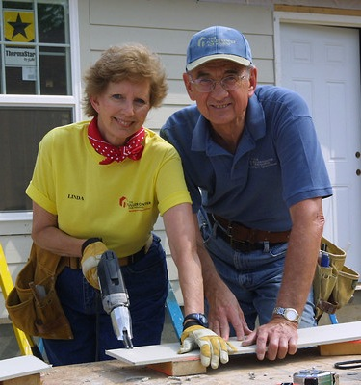
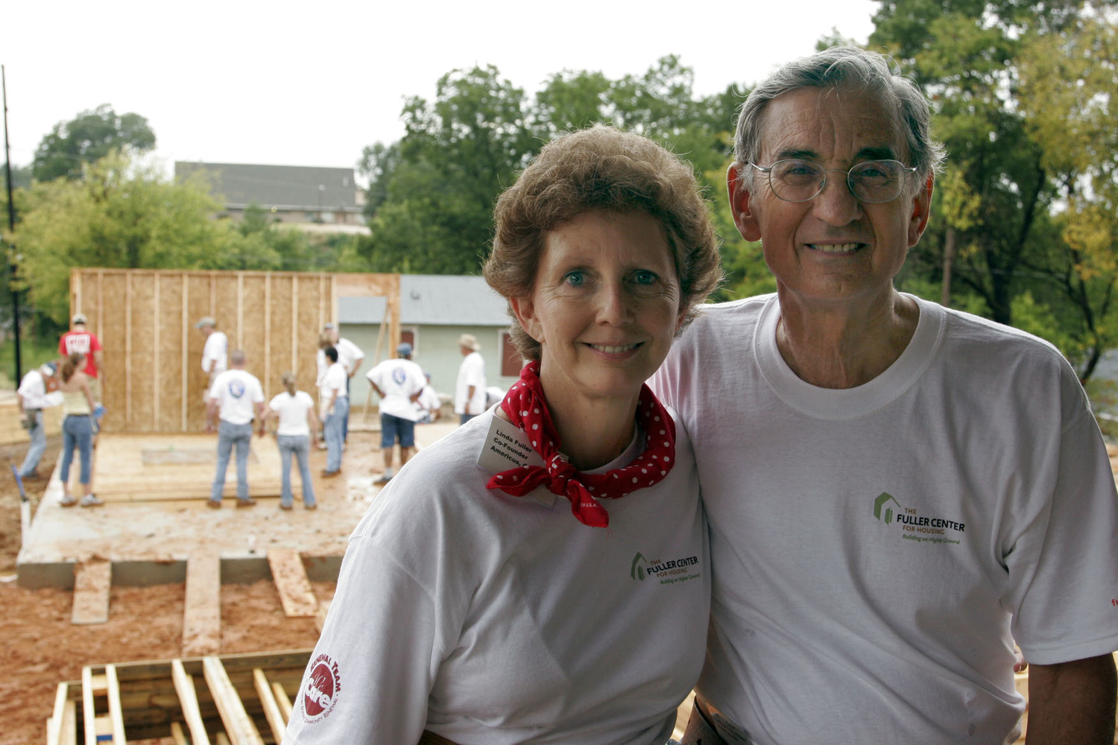
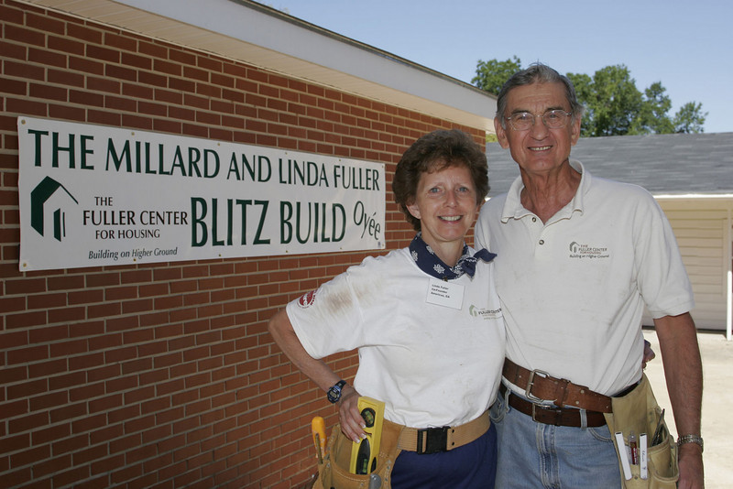
History of Habitat for Humanity
In 1976, Habitat for Humanity International founded by Millard and Linda Fuller

Slide 3


Mission of Habitat
Mission Vision: A world where everyone has a decent place to live.
Mission Statement: Seeking to put God’s love into action, Habitat for Humanity brings people together to build homes, communities and hope
Mission Principles
  Demonstrate the love of Jesus Christ
  Focus on shelter
  Advocate for affordable housing
  Promote dignity and hope
  Support sustainable and transformational development

Slide 4
Habi-facts
Dedicated to the elimination of poverty housing by building simple, decent, affordable homes
Volunteer labor and donations of money and materials help build homes with the partner family
Not a give-away program – houses are SOLD at
no profit and are financed with affordable loans
Home buyers’ monthly payments are used to build
new homes for families in need of affordable housing

Slide 5

Headline here
Add text or bullet points here
Notes:
Because of this House: https://youtu.be/_fWqcVxUvRQ?list=LLsZKzNGEAJ94zmIxPElAgFQ

Slide 6

Criteria for Selection
Need for adequate housing
Ability to Pay
Willingness to partner
Reside within Riley or Pottawatomie Counties for a minimum of one year

Slide 7

Need for Adequate Shelter
Housing may be considered inadequate due to:
  Size of dwelling
  Number of bedrooms and bathrooms
  Structural or dysfunctional issues
  Neighborhood
A Home Visit will be scheduled after completed application is received.

Slide 8
Home Visit
The purpose of the Home Visit is to document the need for affordable and adequate housing and answer questions
You must attend initial credit counseling session before the Home Visit will be scheduled
The Home Visit will NOT be scheduled until you have timely completed all application requirements

Slide 9
Ability to Pay
Family’s gross monthly income should be at least $2,100 per month ($25,200 per year) or more dependent upon family size
MAHFH will consider an applicant/co-applicant’s total stable income (may include the following):
  Public assistance
  Food stamps
  Child support/alimony
  Disability income
  Wages from employment

Slide 10
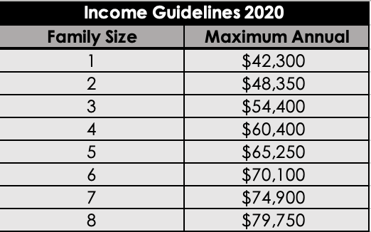
Income Guidelines
Family must have a steady income of at least $ 2,100 per month ($25,200 per year)
Subject to change upon release of new guidelines

Slide 11
Financial Requirements
Homeowner payments provide Habitat with money to build homes for additional homeowners
Required to pay closing costs
Homebuyers are required to have closing cost money in an Individual Development Account (IDA) through the CASH program. You will be matched with $2 for every $1 your save
You save $500 – CASH matches $1,000

Slide 12


Interest Savings
Traditional Mortgage
Habitat for Humanity
Mortgage
$100,000 Home
5% Interest Rate
30 Year Mortgage
You Pay a Total of
$193,255
For your Home!
$100,000 Home
0% Interest Rate
20-30 Year Mortgage
You Pay a Total of
$100,000
For your Home!

Slide 13
Equity/Silent Second Mortgage (EXAMPLE)
$100,000 Construction Cost of Home
$130,000 Appraised Cost of Home
Silent Second Mortgage is
$30,000
Silent Second Mortgage amount reduces over the course of your mortgage
Silent Second Mortgage is payable to MAHFH ONLY upon the sale of your home
If you pay off your mortgage completely - Silent Second Mortgage is NEVER PAID

Slide 14
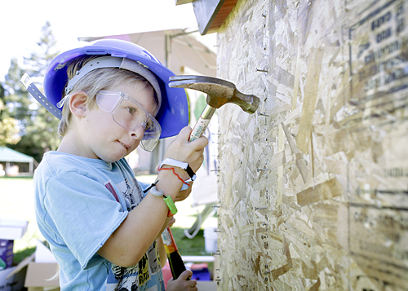
Willingness to Partner
Willingness to partner is
determined primarily through
Sweat Equity
The purpose of sweat equity is to teach skills to maintain your home, to build positive relationships with volunteers and other homeowners, and to help with life-skills that will serve to benefit your family

Slide 15
Sweat Equity
Sweat Equity: 200 hours per adult to be
completed during your partnership with
MAHFH before closing on your home

Slide 16
Credit Counseling - Application Requirement
Credit Counseling is an application requirement
  Schedule and attend initial credit counseling session with MAHFH appointed financial counselor
  IMPORTANT: YOUR APPLICATION IS NOT COMPLETE AND WILL NOT BE ACCEPTED UNTIL YOU HAVE ATTENDED CREDIT COUNSELING

Slide 17
Application Process Recap
Schedule and attend credit counseling session - submit report with application. HCCI – 800-234-0217
Gather and send required documents to office the MAHFH office
Submit by March 1, 2021
MAHFH reviews application and notifies qualified applicants

Slide 18
Application Approval
After MAHFH reviews completed application, application approval will depend on the following criteria:
  demonstrated need for affordable housing: home visit
  ability to pay: fall within income guidelines and save closing costs
  willingness to partner: sweat equity and training

Slide 19
IMPORTANT!
Approved application DOES NOT mean you will receive a home if you do not complete all requirements
Approved applicants will be notified by mail
Approved applicants are required to make acceptable progress toward sweat equity requirements and attend homebuyer training

Slide 20

Is a Habitat Home for You?
Are you able to make monthly mortgage payments on time?
Are you willing to perform sweat equity hours?
Are you willing to attend training?
Are you willing to receive budget and financial counseling?
Did you say Yes! to all of these questions? If so, please pick-up an application when you leave

Slide 21

Application Process - Recap
Complete Application
Gather and copy required documents
Schedule and attend credit counseling session - submit report with application. HCCI – 800-234-0217
Timely submit completed application and all required documents to MAHFH office 727 Poyntz Ave – Lower Lobby
MAHFH reviews application and notifies qualified applicants

Slide 22
Thank You!
Applications are Due:
March 1, 2021

Slide 23

Notes:
We are Habitat Video
https://youtu.be/JHi-RNWKVZU?list=LLsZKzNGEAJ94zmIxPElAgFQ

